Slide 1
Lecture 7
Runge-Kutta Methods
Introduction

Slide 2
Introduction
So far we learned only one IVP solver: Euler’s method
Euler’s method is not precise at all (global truncation error is in first order in the step size)
Several strategies exist to derive high order IVP solvers
A popular family of methods are the Runge-Kutta family
In this first lecture on Runge-Kutta methods we present an intuitive approach to them
Notes:
So far we learned only one IVP solver: Euler’s method
Euler’s method is not precise at all.
Recall that the global truncation error is in first order in the step size
To generate more accurate approximations higher order methods are required
Several strategies exist to derive high order IVP solvers
A popular family of methods are the Runge-Kutta family first developed by the two German mathematicians Carl David Tolmé Runge and Martin Wilhelm Kutta a little bit more than one hundred years ago.
In this first lecture on Runge-Kutta methods we present an intuitive approach to them

Slide 3




















Intuitive idea of Runge-Kutta methods
Euler’s method
Runge-Kutta method
$$y$$
$$y$$
$$w_{i+1}$$
$$w_{i+1}$$
$$f(t_{i},w_{i})$$
$$hf(t_{i},w_{i})$$
$$φ(t_{i},w_{i},h)$$
$$hφ(t_{i},w_{i},h)$$
$$w_{i}$$
$$w_{i}$$
$$w_{i+1}=w_{i}+hf\left(t_{i},w_{i}\right)$$
$$w_{i+1}=w_{i}+hφ\left(t_{i},w_{i},h\right)$$
$$t_{i}$$
$$t_{i+1}$$
$$t$$
$$t_{i}$$
$$t_{i+1}$$
$$t$$
$$h$$
$$h$$
Notes:
Let us first give an intuitive understanding of the Runge-Kutta methods
We first consider the familiar Euler method
This IVP solver extrapolates linearly an approximation wi in ti to ti+1
The slope used for the extrapolation is the slope f(ti,wi) given by the differential equation
Runge-Kutta methods do essentially the same
They as well extrapolate linearly an approximation wi in ti to ti+1
But they compute differently the slope for the extrapolation
They use an expression $φ(t_{i},w_{i},h)$ which aims to give a better slope than simply $f(t_{i},w_{i})$
In this first lecture on Runge-Kutta methods we will discuss two simple examples on how they determine this expression $φ(t_{i},w_{i},h)$

Slide 4
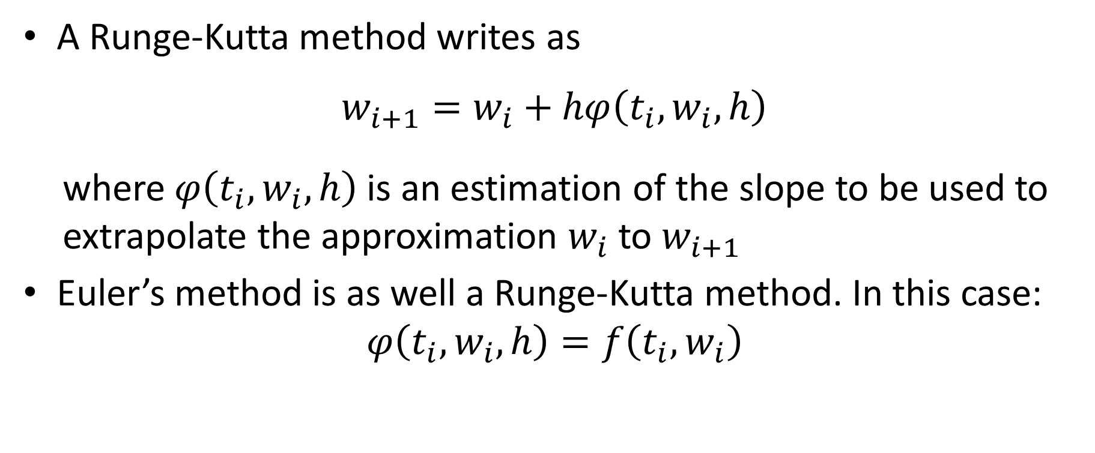
Intuitive idea of Runge-Kutta methods
A Runge-Kutta method writes as
$$w_{i+1}=w_{i}+hφ\left(t_{i},w_{i},h\right)$$
where $φ\left(t_{i},w_{i},h\right)$ is an estimation of the slope to be used to extrapolate the approximation $w_{i}$ to $w_{i+1}$
Euler’s method is as well a Runge-Kutta method. In this case:
$$φ\left(t_{i},w_{i},h\right)=f\left(t_{i},w_{i}\right)$$
Notes:
More formally, a Runge-Kutta method writes as
$$w_{i+1}=w_{i}+hφ\left(t_{i},w_{i},h\right)$$
where $φ\left(t_{i},w_{i},h\right)$ is an estimation of the slope to be used to extrapolate the approximation $w_{i}$ to $w_{i+1}$
In fact Euler’s method is as well a Runge-Kutta method
In this case we have simply $φ\left(t_{i},w_{i},h\right)=f\left(t_{i},w_{i}\right)$

Slide 5


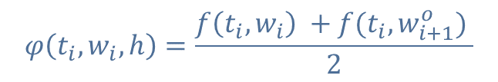

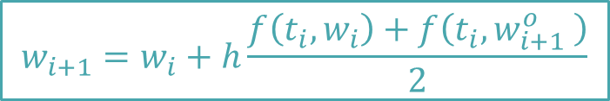






The Trapezoid Method
$$y$$
$$f(t_{i},w_{i+1}^{o})$$
$$w_{i+1}^{o}$$
$$f(t_{i},w_{i})$$
$$w_{i+1}$$
$$w_{i+1}=w_{i}+h\frac{f\left(t_{i},w_{i}\right)+f\left(t_{i},w_{i+1}^{o} \right)}{2}$$
$$w_{i}$$
$$φ\left(t_{i},w_{i},h\right)=\frac{f\left(t_{i},w_{i}\right) +f(t_{i},w_{i+1}^{o}) }{2}$$
$$t_{i}$$
$$t_{i+1}$$
$$t$$
Notes:
Let us now see a first example of a more advanced Runge-Kutta method than Euler’s algorithm
This method is called the trapezoid method
Without going into the details, the name of this method comes from the fact that it could be derived out of the Trapezoid quadrature formula
We present here a different, more intuitive approach
Imagine we have an approximation wi in ti.
A local solution will pass by this approximation
Euler’s method extrapolates wi using the slope f(ti,wi) to ti+1
Let’s call this approximation $w_{i+1}^{o}$
Now what the trapezoid IVP solvers does is to use not the slope f(ti,wi) to conduct the extrapolation but rather the average of the slope f(ti,wi) and $f(t_{i},w_{i+1}^{o})$
Which means that $φ\left(t_{i},w_{i},h\right)=\frac{f\left(t_{i},w_{i}\right) +f(t_{i},w_{i+1}^{o}) }{2}$
The linear extrapolation using this slope results in $w_{i+1}$
This approximation is calculated as
$w_{i+1}=w_{i}+h\frac{f\left(t_{i},w_{i}\right)+f\left(t_{i},w_{i+1}^{o} \right)}{2}$

Slide 6
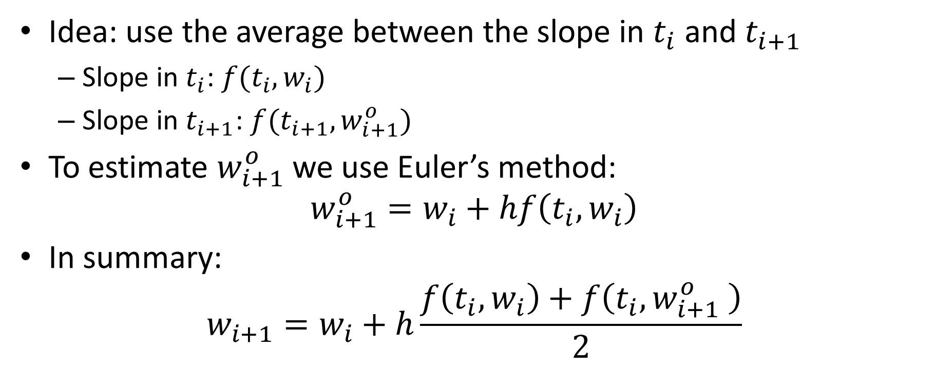
The Trapezoid Method
Idea: use the average between the slope in $t_{i}$ and $t_{i+1}$
Slope in $t_{i}$: $f(t_{i},w_{i})$
Slope in $t_{i+1}$: $f(t_{i+1},w_{i+1}^{o})$
To estimate $w_{i+1}^{o}$ we use Euler’s method:
$$w_{i+1}^{o}=w_{i}+hf\left(t_{i},w_{i}\right)$$
In summary:
$$w_{i+1}=w_{i}+h\frac{f\left(t_{i},w_{i}\right)+f\left(t_{i},w_{i+1}^{o} \right)}{2}$$
Notes:
Formally we can describe the trapezoid IVP solver as follows
The idea is to use the average between the slope in $t_{i}$ and $t_{i+1}$
The slope in $t_{i}$ is equal to $f(t_{i},w_{i})$
The slope in $t_{i+1}$is equal to $f(t_{i+1},w_{i+1}^{o})$
To estimate $w_{i+1}^{o}$ we use Euler’s method, that is$w_{i+1}^{o}=w_{i}+hf\left(t_{i},w_{i}\right)$
Putting all together:
$$w_{i+1}=w_{i}+h\frac{f\left(t_{i},w_{i}\right)+f\left(t_{i},w_{i+1}^{o} \right)}{2}$$

Slide 7

Written in the Runge-Kutta way
One defines:
$k_{1}=f\left(t_{i},w_{i}\right)$
$k_{2}=f\left(t_{i}+h,w_{i}+k_{1}h\right)$
Trapezoid-method:
$$w_{i+1}=w_{i}+h\left(\frac{1}{2}k_{1}+\frac{1}{2}k_{2}\right)$$
Notes:
There is a more efficient way to write down this algorithm
This way is used in the Runge-Kutta IVP solvers
For this one defines two auxiliary variables k1 and k2
K1 is defined as $f\left(t_{i},w_{i}\right)$
K2 is defined as $f\left(t_{i}+h,w_{i}+k_{1}h\right)$
Then the Trapezoid IVP solvers writes
$$w_{i+1}=w_{i}+h\left(\frac{1}{2}k_{1}+\frac{1}{2}k_{2}\right)$$
This equation is exactly the same we presented in the two previous slides.
But the introduction of the variables k1 and k2 make it much more efficient when computing it either by hand or in a computer code

Slide 8

Example
We want to solve
$$\left\{\begin{aligned}\frac{dy}{dt}=ty+t^{3} \\ y\left(0\right)=1\end{aligned}\right.$$
with the Runge-Kutta Trapezoid method
Notes:
Let us apply the trapezoid IVP solver to a sample problem
We consider the initial value problem $\frac{dy}{dt}=ty+t^{3}$ with initial condition y(0)=1

Slide 9
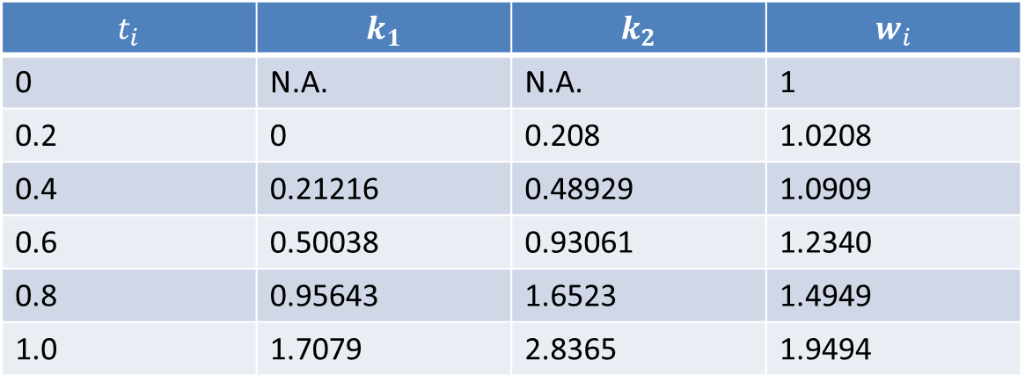
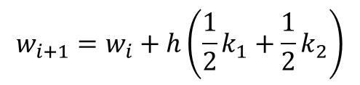



Example
We organize the calculations in a table
$$\left\{\begin{aligned}\frac{dy}{dt}=ty+t^{3} \\ y\left(0\right)=1\end{aligned}\right.$$
$$t_{i}$$ | $$k_{1}$$ | $$k_{2}$$ | $$w_{i}$$
0 | N.A. | N.A. | 1
0.2 | 0 | 0.208 | 1.0208
0.4 | 0.21216 | 0.48929 | 1.0909
0.6 | 0.50038 | 0.93061 | 1.2340
0.8 | 0.95643 | 1.6523 | 1.4949
1.0 | 1.7079 | 2.8365 | 1.9494
$$k_{1}=f\left(t_{i},w_{i}\right)$$
$$k_{2}=f\left(t_{i}+h,w_{i}+k_{1}h\right)$$
$$w_{i+1}=w_{i}+h\left(\frac{1}{2}k_{1}+\frac{1}{2}k_{2}\right)$$
Notes:
Organizing the calculations in a table is very useful
We present the calculations for the case one chooses h=0.2
At first we enter the initial condition.
At this point k1 and k2 are not defined, and not needed neither of course
To compute the approximation w1 in t1, in our example 0.2, one needs to compute k1 and k2 using the entries form the line above.
Once k1 and k2 computed, one can then calculate w1
One proceeds like this for each ti until one reaches the desired tf, in our case 1

Slide 10
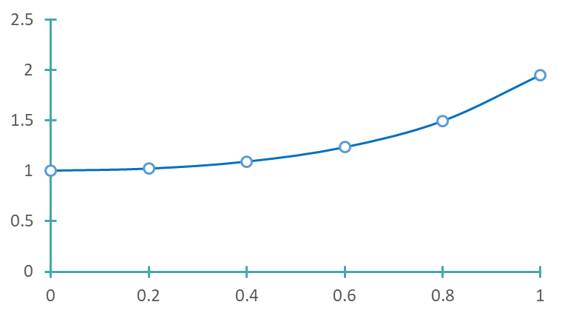



Example
$$y$$
$$y\left(t\right)={3e}^{t^{2}/2}−t^{2}−2$$
$$t$$
Notes:
The graph displays the computed approximations (the circles) together with the exact solution (the smooth line)
Note how precise the approximations are. Almost no difference can be detected
It is worth to compare with the approximations generated by Euler’s method for the same IVP we presented in a previous lecture.
The trapezoid IVP solver generates much better approximations than Euler’s method for a same value of the step size h

Slide 11











The Midpoint Method
$$y$$
$$f(t_{i+1/2},w_{i+1/2}^{o})$$
$$w_{i+1/2}^{o}$$
$$w_{i+1}=w_{i}+hf\left(t_{i+1/2},w_{i+1/2}^{o}\right)$$
$$f(t_{i},w_{i})$$
$$w_{i}$$
$$φ\left(t_{i},w_{i},h\right)=f\left(t_{i+1/2},w_{i+1/2}^{o} \right)$$
$$t_{i+1/2}$$
$$t_{i+1}$$
$$t$$
$$t_{i}$$
$$h/2$$
Notes:
We want now to present a second example of a Runge-Kutta method
This method is called the midpoint method
Imagine we have an approximation wi in ti.
A local solution will pass by this approximation
Euler’s method would extrapolate wi using the slope f(ti,wi).
Let us extrapolate wi using Euler’s method to ti+h/2.
We call ti+h/2 ti+1/2
And we call the Euler approximation in ti+1/2 $w_{i+1/2}^{o}$
Now what the midpoint IVP solvers does is to use not the slope f(ti,wi) to conduct the extrapolation but rather the slope f(ti+1/2,wi+1/2)
The linear extrapolation using this slope results in $w_{i+1}$
This approximation is calculated as
$w_{i+1}=w_{i}+hf\left(t_{i+1/2},w_{i+1/2}^{o}\right)$

Slide 12
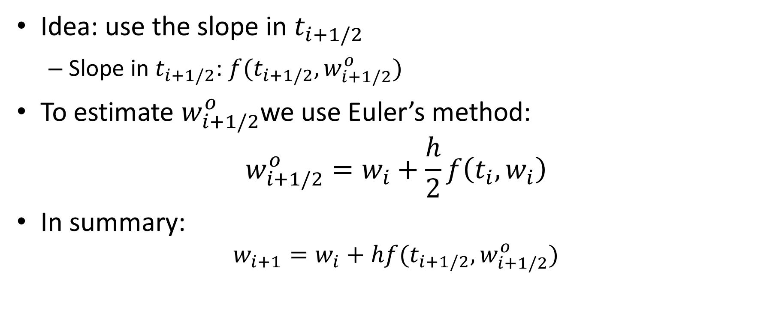
The Midpoint Method
Idea: use the slope in $t_{i+1/2}$
Slope in $t_{i+1/2}$: $f(t_{i+1/2},w_{i+1/2}^{o})$
To estimate $w_{i+1/2}^{o}$we use Euler’s method:
$$w_{i+1/2}^{o}=w_{i}+\frac{h}{2}f\left(t_{i},w_{i}\right)$$
In summary:
$$w_{i+1}=w_{i}+hf(t_{i+1/2},w_{i+1/2}^{o})$$
Notes:
Formally we can describe the midpoint IVP solver as follows
The idea is to use the slope in $t_{i+1/2}$which is equal to $f(t_{i+1/2},w_{i+1/2}^{o})$
To estimate $w_{i+1/2}^{o}$ we use Euler’s method, that is$w_{i+1/2}^{o}=w_{i}+\frac{h}{2}f\left(t_{i},w_{i}\right)$
Putting all together:
$$w_{i+1}=w_{i}+hf(t_{i+1/2},w_{i+1/2}^{o})$$

Slide 13

Written in the Runge-Kutta way
One defines:
$k_{1}=f\left(t_{i},w_{i}\right)$
$k_{2}=f\left(t_{i}+\frac{h}{2},w_{i}+\frac{1}{2}k_{1}h\right)$
Midpoint-method:
$$w_{i+1}=w_{i}+{hk}_{2}$$
Notes:
For the trapezoid IVP solver, it is more efficient to introduce two auxiliary variables k1 and k2 to perform the calculations
K1 is defined as $f\left(t_{i},w_{i}\right)$
K2 is defined as$f\left(t_{i}+\frac{h}{2},w_{i}+\frac{1}{2}k_{1}h\right)$
Then the Trapezoid IVP solvers writes
$$w_{i+1}=w_{i}+{hk}_{2}$$
This equation is exactly the same we presented in the two previous slides.
But the introduction of the variables k1 and k2 make it much more efficient when computing it either by hand or in a computer code

Slide 14

Example
We want to solve
$$\left\{\begin{aligned}\frac{dy}{dt}=ty+t^{3} \\ y\left(0\right)=1\end{aligned}\right.$$
with the Runge-Kutta midpoint method
Notes:
Let us apply the midpoint IVP solver to the same problem we did for the trapezoid IVP solver
We consider the initial value problem $\frac{dy}{dt}=ty+t^{3}$ with initial condition y(0)=1

Slide 15
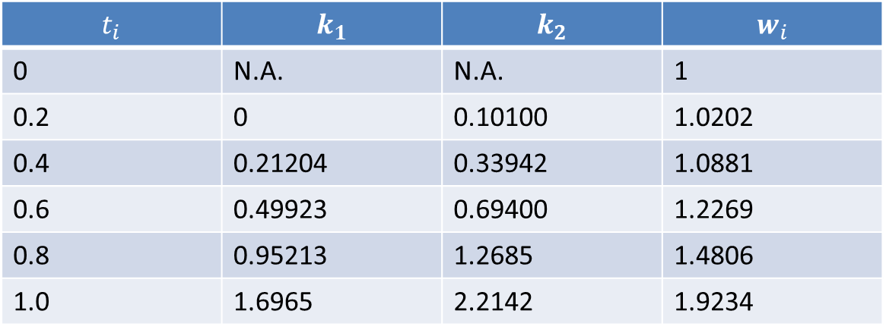

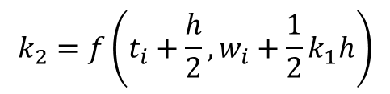
Example
We organize the calculations in a table
$$\left\{\begin{aligned}\frac{dy}{dt}=ty+t^{3} \\ y\left(0\right)=1\end{aligned}\right.$$
$$t_{i}$$ | $$k_{1}$$ | $$k_{2}$$ | $$w_{i}$$
0 | N.A. | N.A. | 1
0.2 | 0 | 0.10100 | 1.0202
0.4 | 0.21204 | 0.33942 | 1.0881
0.6 | 0.49923 | 0.69400 | 1.2269
0.8 | 0.95213 | 1.2685 | 1.4806
1.0 | 1.6965 | 2.2142 | 1.9234
$$k_{1}=f\left(t_{i},w_{i}\right)$$
$$k_{2}=f\left(t_{i}+\frac{h}{2},w_{i}+\frac{1}{2}k_{1}h\right)$$
$$w_{i+1}=w_{i}+{hk}_{2}$$
Notes:
Again, organizing the calculations in a table is very useful
We present the calculations for the case one chooses h=0.2
At first we enter the initial condition.
At this point k1 and k2 are not defined, and not needed neither of course
To compute the approximation w1 in t1, in our example 0.2, one needs to compute k1 and k2 using the entries form the line above.
Once k1 and k2 computed, one can then calculate w1
One proceeds like this for each ti until one reaches the desired tf, in our case 1

Slide 16
Example
$$y$$
$$y\left(t\right)={3e}^{t^{2}/2}−t^{2}−2$$
$$t$$
Notes:
The graph displays the computed approximations (the circles) together with the exact solution (the smooth line)
Note again how precise the approximations are. Almost no difference can be detected
In fact the approximations are very similar to the trapezoid IVP solver
This is not an accident as we will confirm shortly

Slide 17
Octave Code
function [t, w] = RK_trap(f,to,yo,h,n)
w=[yo];
t=[to];
for i = 1:n
k1=f(t(end),w(end));
k2=f(t(end)+h,w(end)+k1*h);
w=[w w(end)+h/2*(k1+k2)];
t=[t t(end)+h];
endfor
endfunction
function [t, w] = RK_mid(f,to,yo,h,n)
w=[yo];
t=[to];
for i = 1:n
k1=f(t(end),w(end));
k2=f(t(end)+h/2,w(end)+h/2*k1);
w=[w w(end)+h*k2];
t=[t t(end)+h];
endfor
endfunction
Notes:
Runge-Kutta methods are very efficient to be programmed
Let us define a function RK_trap to implement the trapezoid IVP solver.
This function will return two vectors.
The vector t will contain the various ti and the vector w will contain the various wi
The function takes 4 arguments
The first one is the function f defining the ODE
The second one is the time to of the initial condition
The third is the corresponding initial value yo
The next argument is the step size h and the last argument is the number n of steps we want to perform
The function start by initializing the vectors w and t by filling them with the initial condition
These two vectors will then progressively be filled further with the calculated values ti and wi
We do this with a for loop running from 1 to n
Inside the loop we calculate the values k1 and k2 as well as wi which we add to the vector w
Note the keyword “end”. This keyword automatically sects the last entry of a vector
We compute as well the time steps ti and add them to the vector t
We close the for loop with the key word endfor and we close the function with the keyword endfunction
In the same way one can define a function RK_mid to implement the midpoint IVP solver
I invite you to try it by yourself
A possible solution is presented on the slide

Slide 18
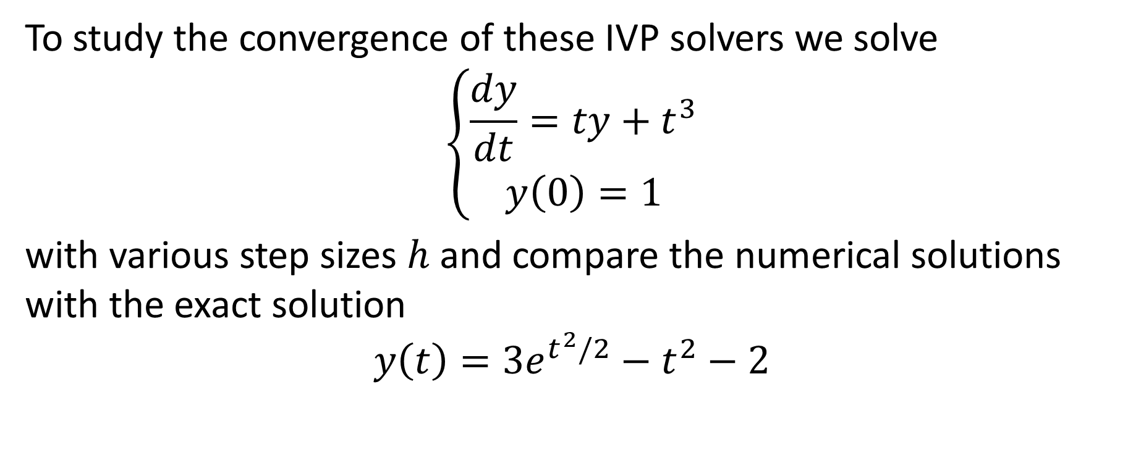
Convergence
To study the convergence of these IVP solvers we solve
$$\left\{\begin{aligned}\frac{dy}{dt}=ty+t^{3} \\ y\left(0\right)=1\end{aligned}\right.$$
with various step sizes $h$ and compare the numerical solutions with the exact solution
$$y\left(t\right)={3e}^{t^{2}/2}−t^{2}−2$$
Notes:
Having defined some octave functions to execute the two Runge-Kutta methods we discussed so far, we can now study on an example the convergence of them
We consider the initial value problem $\frac{dy}{dt}=ty+t^{3}$ with initial condition y(0)=1
We sill solve this problem numerically with our two Runge-Kutta methods for various step sizes and compare the computed approximations with the exact solution $y\left(t\right)={3e}^{t^{2}/2}−t^{2}−2$

Slide 19
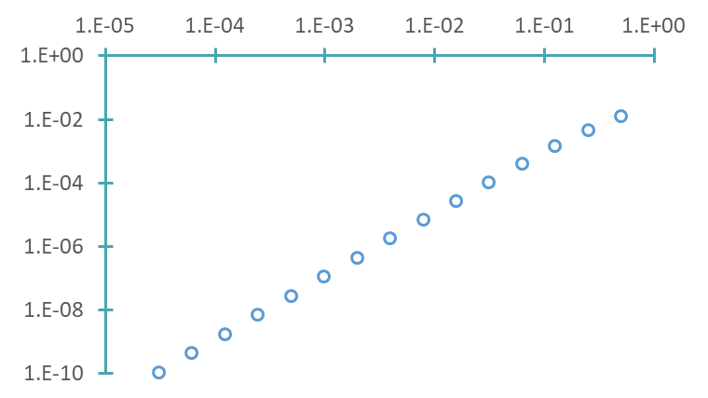
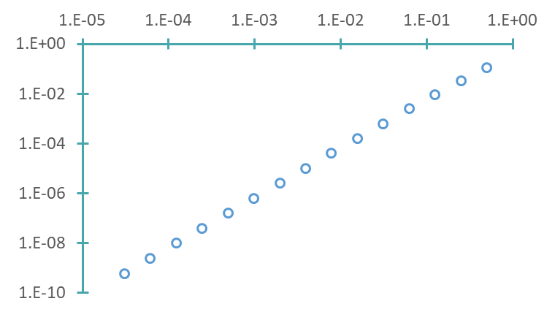








Convergence
Runge-Kutta Trapezoid
Runge-Kutta Midpoint
$$h$$
$$h$$
$$E=O(h^{2})$$
$$E=O(h^{2})$$
True Error$E$in $t=1$
True Error$E$ in $t=1$
$${E≅0.55h}^{1.976}$$
$${E≅0.08h}^{1.945}$$
Both methods are examples of RK2 methods
Notes:
The plot on the slide displays the true error in t=1 in function of various step sizes
The true error is computed by taking the difference, in absolute value, between the true solution in t=1 and the numerical approximation in t=1 calculated by the trapezoid IVP solver, respectively with the midpoint IVP solver. This error is the global truncation error.
I invite you to try to reproduce these graphs with the help of the octave script we presented to implement the trapezoid IVP solver
We can now use a power law to fit these error plots
For the trapezoid IVP solver the power law suggests that the error decreases in second order in h
This is indeed the case. The trapezoid IVP solver is in second order in the step size h for the global truncation error.
Repeating the same exercise with the data from the midpoint IVP solver results in the same conclusion
This confirms that both methods are in second order in the step size h for the global truncation error and will consequently produce very similar approximations for a same step size. Which one is used in practice is a matter of taste as both are as good as each others
In fact both methods are two examples of so called RK2 methods
We will come back on this in more details in a coming lecture

Slide 20
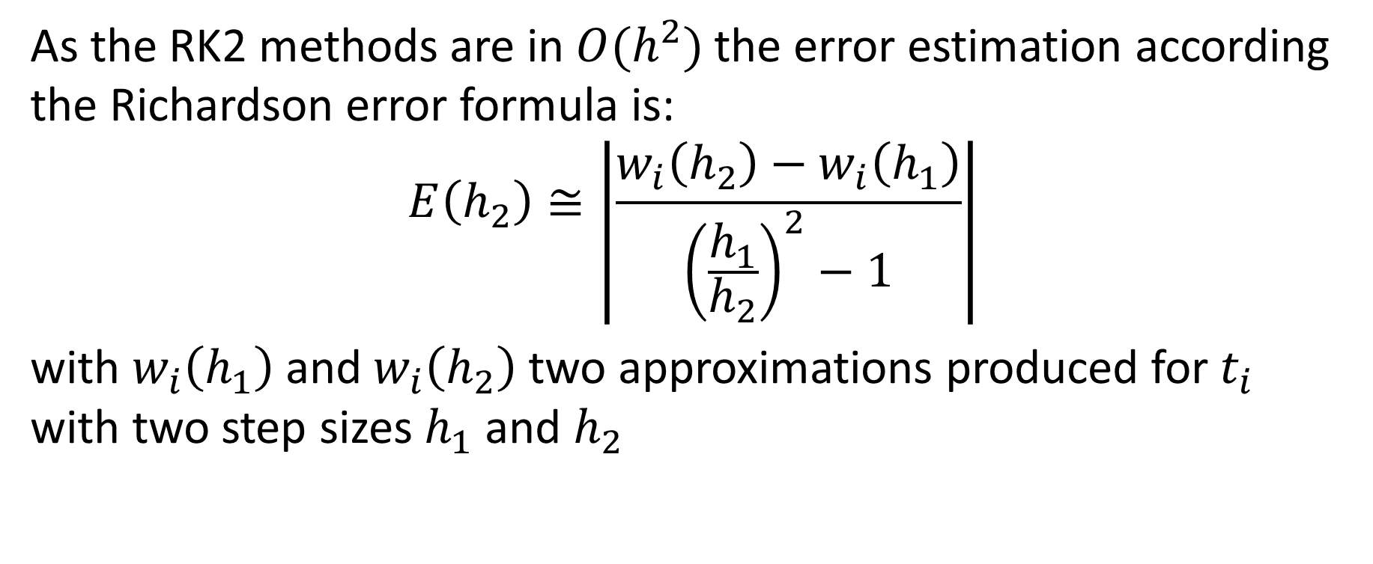
Estimating Truncation Error
As the RK2 methods are in $O(h^{2})$the error estimation according the Richardson error formula is:
$$E\left(h_{2}\right)≅\left|\frac{w_{i}\left(h_{2}\right)−w_{i}\left(h_{1}\right)}{{\left(\frac{h_{1}}{h_{2}}\right)}^{2}−1}\right|$$
with $w_{i}\left(h_{1}\right)$ and $w_{i}\left(h_{2}\right)$ two approximations produced for $t_{i}$ with two step sizes $h_{1}$ and $h_{2}$
Notes:
As the RK2 methods are in $O(h^{2})$, we can use the Richardson error formula to estimate the truncation error.
The error estimation according the Richardson error formula is:
$$E\left(h_{2}\right)≅\left|\frac{w_{i}\left(h_{2}\right)−w_{i}\left(h_{1}\right)}{{\left(\frac{h_{1}}{h_{2}}\right)}^{2}−1}\right|$$
with $w_{i}\left(h_{1}\right)$ and $w_{i}\left(h_{2}\right)$ two approximations produced for $t_{i}$ with two step sizes $h_{1}$ and $h_{2}$

Slide 21
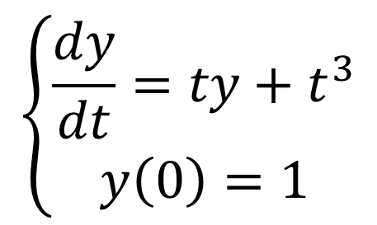

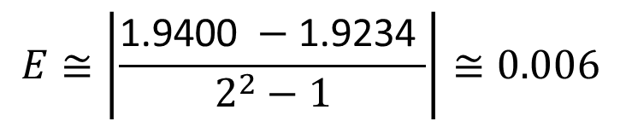
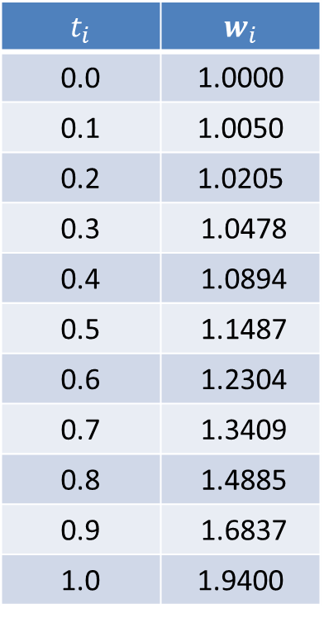
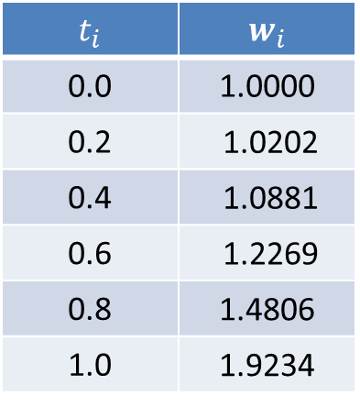
Example
$$t_{i}$$ | $$w_{i}$$
0.0 | 1.0000
0.2 | 1.0202
0.4 | 1.0881
0.6 | 1.2269
0.8 | 1.4806
1.0 | 1.9234
$$t_{i}$$ | $$w_{i}$$
0.0 | 1.0000
0.1 | 1.0050
0.2 | 1.0205
0.3 | 1.0478
0.4 | 1.0894
0.5 | 1.1487
0.6 | 1.2304
0.7 | 1.3409
0.8 | 1.4885
0.9 | 1.6837
1.0 | 1.9400
$$\left\{\begin{aligned}\frac{dy}{dt}=ty+t^{3} \\ y\left(0\right)=1\end{aligned}\right.$$
$$E≅\left|\frac{\text{1.9400} −\text{1.9234} }{2^{2}−1}\right|≅0.006$$
$$y(1)≅\text{1.94}0±0.006$$
Notes:
Let us verify the validity of the Richardson error formula with an example
The two tables displayed list numerical solutions computed by the trapezoid IVP solver for the initial value problem $\frac{dy}{dt}=ty+t^{3}$ with initial condition y(0)=1.
The first table was produced using the step size h1=0.2 whereas the second one was computed with the step size h2=0.1
We can now estimated the truncation error for the approximation in t=1
For this we apply Richardson's error formula using the two approximations in t=1 which results in about 0.006
Consequently we can say that $y(1)≅\text{1.94}0±0.006$
I invite you to compare this estimation with the true value in t=1. You will realize that the error estimation is perfectly valid

Slide 22
Summary
We presented two examples of Runge-Kutta methods
The trapezoid IVP solver
The midpoint IVP solver
Both methods are examples of so-called RK2 methods
The global truncation error of these methods is in second order in the step size
Richardson's error formula can be used to estimate the global truncation error
Notes:
Let us summarize the key findings
We presented two examples of Runge-Kutta methods:
The trapezoid IVP solver
And the midpoint IVP solver
Both methods are examples of so-called RK2 methods
The global truncation error of these methods is in second order in the step size
Richardson's error formula can be used to estimate the global truncation error

